Slide 1

Analysis of Mortgage Insurance and Fannie Mae MBS Loan Defaults and Other Metrics Q1 2015 – Q1 2019
Juliette Lu
Capstone Project No. 1

Slide 2

Description
Objective
Explore the relationship between mortgage insurance (MI) coverage and mortgage-backed security (MBS) loan defaults and other metrics
Questions:
Are there differences in default occurrence and other characteristics between loans that are insured vs. loans that are not insured?
For loans that are insured, are there differences in these characteristics between loans where borrowers pay premiums vs. loans where lenders pay premiums?

Slide 3
Overview
Mortgage-Backed-Securities (MBS)
Investments made up of a bundle of home loans (mortgages)
Each loan backed by a single-family of borrowers who uses the loan to finance the purchase of a home or property
Investors in MBS receive periodic payments similar to coupon payments from bonds.
Mortgage Insurance
Policy that protects a mortgage lender if the borrower defaults on payments or otherwise cannot meet the contractual obligations of the mortgage
Fannie Mae requires mortgage insurance for borrowers whose loan-to-value (LTV) ratios are 80% or higher to offset the risk to the lender.
LTV measures the ratio of the outstanding amount due to the market value of the underlying property

Slide 4
Data
Fannie Mae
Single-Family Fixed Rate 30-year and less mortgages
Acquisitions dataset (loan-level)
Performance dataset (loan and month-level)
Quarterly level files
Data Transformation
Subset to loans originated in Q1 2015
Track performance for four years from origination date
Default: Any 90+ day delinquency in four-year period from origination date

Slide 5
Loan Summary Statistics
266,662 loans
1.0 % default in the Q1 2015 – Q1 2019 period
14.0 % are first-time-home purchases
86.8 % are primary residences
Statistic | UPB | Loan Term (Months) | Loan-to-Value (LTV) Ratios | Debt-to-Income (DTI) Ratios | FICO Credit Scores
mean | $232,505 | 315 | 73 | 33 | 756
std | $118,120 | 77 | 16 | 9 | 46
min | $11,000 | 60 | 3 | 1 | 557
25% | $140,000 | 240 | 65 | 27 | 726
50% | $213,000 | 360 | 77 | 34 | 768
75% | $310,000 | 360 | 80 | 41 | 793
max | $1,203,000 | 360 | 97 | 51 | 834

Slide 6
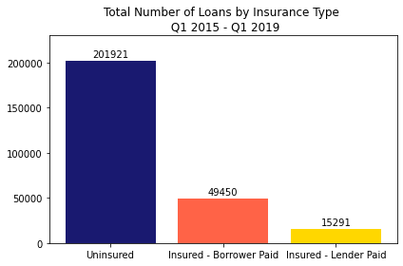
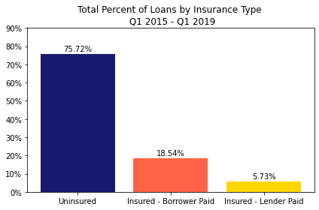
Loans by Mortgage Insurance Type
201,921 uninsured loans (76%)
64,741 insured loans (24%)
49,450 borrower-paid premiums
15,291 lender-paid premiums

Slide 7
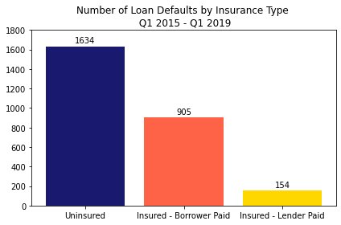
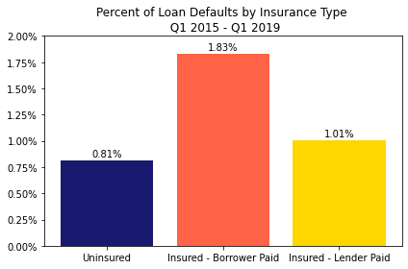
Loan Defaults by Mortgage Insurance Type

Slide 8
Metrics for Hypothesis Tests
Recap
Are there differences in metrics between:
Insured vs. uninsured loans
Insured (borrower-paid) vs. Insured (lender-paid) loans
Credit Risk Metrics
Default Incidence
Debt-to-Income Ratio (DTI)
Loan-to-Value Ratio (LTV)
Original Unpaid Principal Balance (UPB)
First-Time Home Buyer
Credit Worthiness Metrics
FICO Credit Scores
Primary Residence
Alpha = 0.05

Slide 9
Insured vs. Uninsured Loans

Slide 10
Insured vs. Uninsured Loans: Credit Risk Metrics
Default Incidence
Debt-to-Income Ratio (DTI)
Loan-to-Value Ratio (LTV)
Original Unpaid Principal Balance (UPB)
First-Time Home Buyer
H₀ : Uninsured loans have the same credit risk metric values as do insured loans.
H_{A}: Uninsured loans have different credit risk metric values than do insured loans.

Slide 11
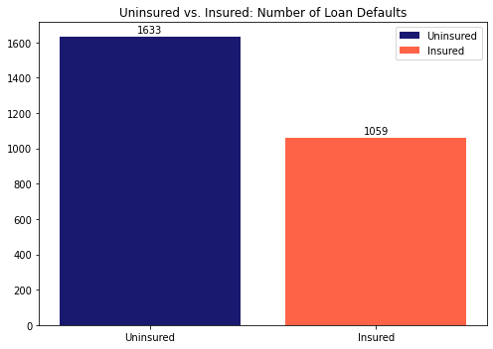
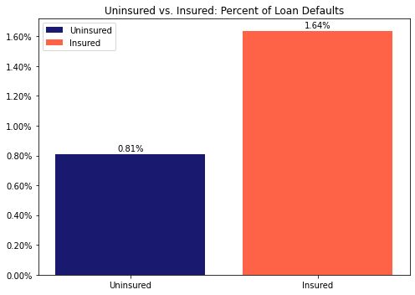
Insured vs. Uninsured Loans: Defaults
H₀ : Uninsured loans default just as frequently as insured loans.
H_{A} : Uninsured loans default either more or less often than insured loans.

Slide 12
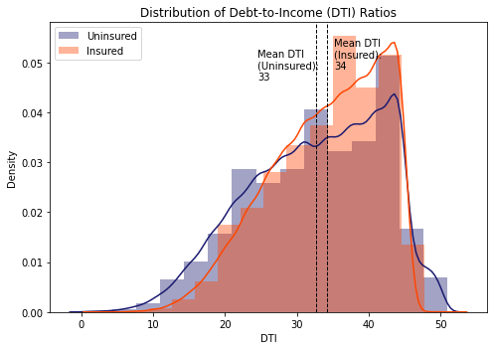
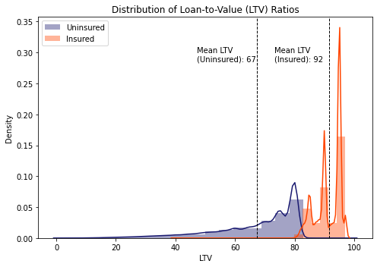
Insured vs. Uninsured Loans: Credit Risk Metrics Distribution

Slide 13
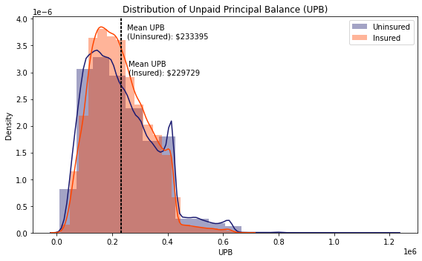
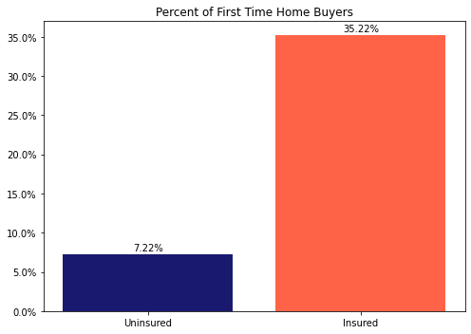
Insured vs. Uninsured Loans: Credit Risk Metrics Distribution

Slide 14
Insured vs. Uninsured Loans: Credit Risk Metrics Results
We reject the null hypothesis that uninsured loans have the same credit risk metrics as do uninsured loans
Metric | Welch’s T-test P-value | Mann-Whitney U Test P-value
Default | 1.8 x 10⁻⁵³ | 6.0 x 10⁻⁷⁵
LTV | 0.0 | 0.0
DTI | 0.0 | 1.3 x 10⁻¹⁹⁸
UPB | 3.8 x 10⁻¹⁴ | 7.7 x 10⁻⁸
First-Time Home Buyer | 0.0 | 0.0

Slide 15
Insured vs. Uninsured Loans: Credit Worthiness Metrics
FICO Credit Scores
Primary Residence Loans
H₀ : Uninsured loans have the same credit worthiness metric values as do insured loans.
H_{A} : Uninsured loans have different credit worthiness metric values than do insured loans.

Slide 16
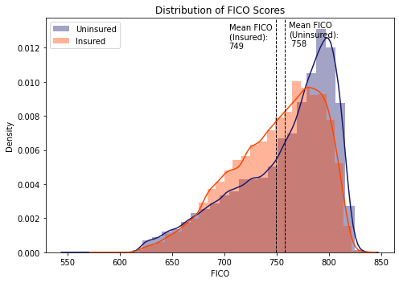
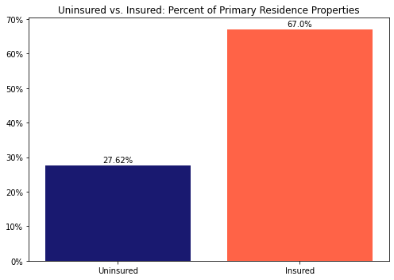
Insured vs. Uninsured Loans: Credit Worthiness Metrics Distribution

Slide 17
Insured vs. Uninsured Loans: Credit Worthiness Metrics Results
We reject the null hypothesis that uninsured loans have the same credit-worthiness metric values as do insured loans.
Metric | Welch’s T-test P-value | Mann-Whitney U Test P-value
FICO Credit Score | 0.0 | 0.0
Primary Residence | 0.0 | 0.0

Slide 18
Insured vs. Uninsured Loans: Results with Bonferroni Correction
With seven metrics, the probability that we get at least one significant result due to random chance is = 30.2%
1 - (1 - 0.05)⁷
Metric | Welch’s T-test Adjusted P-value | Mann-Whitney U Test Adjusted P-value
Default | 1.3 x 10⁻⁵² | 4.2 x 10⁻⁷⁴
LTV | 0.0 | 0.0
DTI | 0.0 | 9.9 x 10⁻¹⁹⁸
UPB | 2.7 x 10⁻¹³ | 5.4 x 10⁻⁷
First-Time Home Buyer | 0.0 | 0.0
FICO Credit Score | 0.0 | 0.0
Primary Residence | 0.0 | 0.0
We still reject the null hypotheses for each of these metrics.

Slide 19
Insured (Borrower Paid) vs. Insured Loans (Lender Paid) Loans H₀ : Borrower-paid loans have the same credit risk and worthiness metric values as do lender-paid loans. H_{A}: Borrower-paid loans have different credit risk and worthiness metric values than do lender-paid loans.

Slide 20
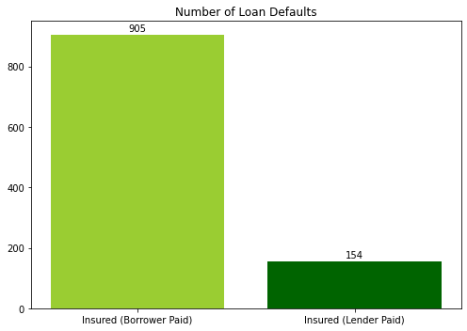
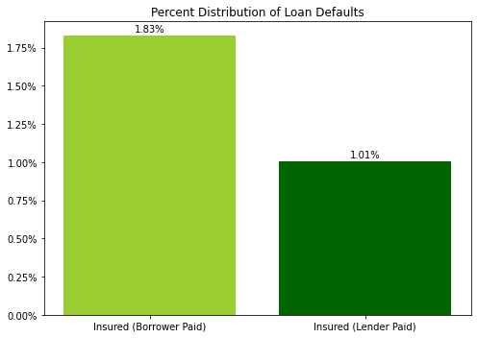
Insured (Borrower Paid) vs. Insured Loans (Lender Paid): Credit Risk Metrics Distributions

Slide 21
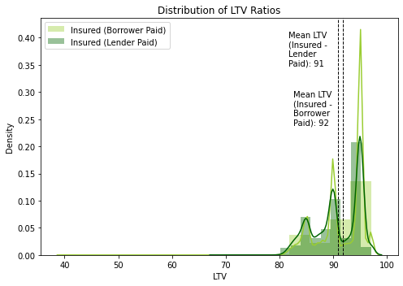
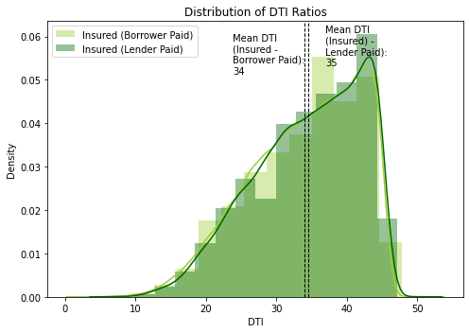
Insured (Borrower Paid) vs. Insured Loans (Lender Paid): Credit Risk Metrics Distributions

Slide 22
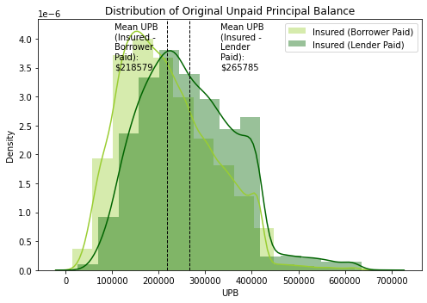
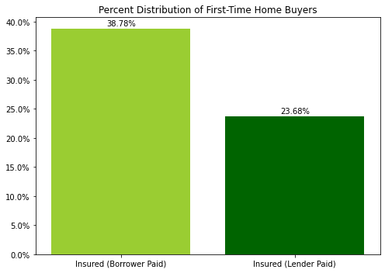
Insured (Borrower Paid) vs. Insured Loans (Lender Paid): Credit Risk Metrics Distributions

Slide 23
Insured (Borrower Paid) vs. Insured Loans (Lender Paid): Credit Risk Metrics Results
We reject the null hypothesis that insured loans where borrowers pay premiums have the same credit risk metric values as do insured loans where lenders pay premiums.
Metric | Welch’s T-test P-value | Mann-Whitney U Test P-value
Default | 3.3 x 10⁻¹⁶ | 2.4 x 10⁻¹²
LTV | 2.6 x 10⁻¹²⁵ | 3.7 x 10⁻¹⁵⁶
DTI | 2.0 x 10⁻¹¹ | 1.2 x 10⁻¹⁰
UPB | 0.0 | 0.0
First-Time Home Buyer | 1.9 x 10⁻²⁹³ | 6.8 x 10⁻²⁵⁶

Slide 24
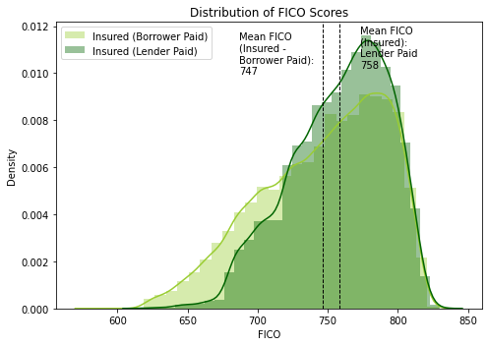
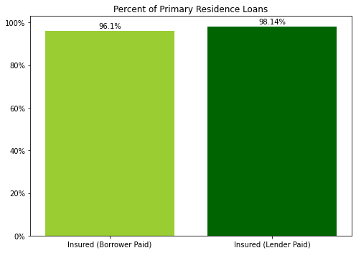
Insured (Borrower Paid) vs. Insured Loans (Lender Paid): Credit Worthiness Metrics Distributions

Slide 25
Insured (Borrower Paid) vs. Insured Loans (Lender Paid): Credit Worthiness Metrics Results
We reject the null hypothesis that insured loans where borrowers pay premiums have the same credit worthiness metric values as do insured loans where lenders pay premiums
Metric | Welch’s T-test P-value | Mann-Whitney U Test P-value
FICO Credit Score | 7.4 x 10⁻²⁵² | 2.6 x 10⁻¹³⁸
Primary Residence | 4.8 x 10⁻⁴⁸ | 8.0 x 10⁻³⁴

Slide 26
Insured (Borrower Paid) vs. Insured Loans (Lender Paid): Results with Bonferroni Correction
We still reject the null hypotheses for all metrics
Metric | Welch’s T-test Adjusted P-value | Mann-Whitney U Test Adjusted P-value
Default | 2.3 x 10⁻¹⁵ | 1.6 x 10⁻¹¹
LTV | 1.8 x 10⁻¹²⁴ | 2.6 x 10⁻¹⁵⁵
DTI | 1.4 x 10⁻¹⁰ | 8.7 x 10⁻¹⁰
UPB | 0.0 | 0.0
First-Time Home Buyer | 1.3 x 10⁻²⁹² | 4.8 x 10⁻²⁵⁵
FICO Credit Score | 5.2 x 10⁻²⁵¹ | 1.8 x 10⁻¹³⁷
Primary Residence | 3.3 x 10⁻⁴⁷ | 5.6 x 10⁻³³

Slide 27
Summary & Implications
Insured vs. Uninsured
Significant differences in all credit-worthiness and credit-risk metrics
Mortgage Insurance an indicator of borrower riskiness
Insured (Borrower-Paid Premiums) vs. Insured (Lender-Paid Premiums)
Significant differences in all credit-worthiness and credit-risk metrics
Borrower-paid premiums an indicator of borrower riskiness

Slide 28
Questions?

Slide 29
Appendix

Slide 30
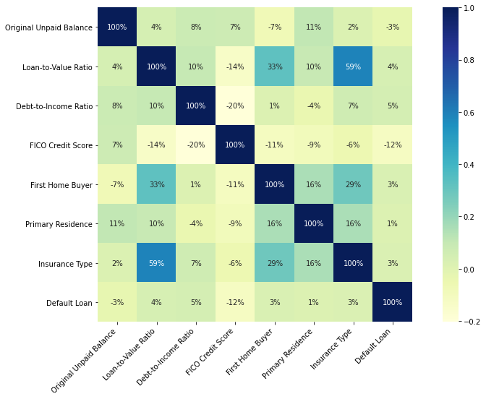
Correlation Matrix of MBS Loan Characteristics

Slide 31
Summary Statistics, by Mortgage Insurance Type
Metric |  | Mortgage Insurance Type
 |  | Uninsured | Ins - Borrower | Ins - Lender
LTV | count | 201921 | 49450 | 15291
 | mean | 67 | 92 | 91
 | std | 14.21 | 4.09 | 4.28
 | min | 3 | 40 | 69
 | 25% | 60 | 90 | 88
 | 50% | 73 | 94 | 90
 | 75% | 80 | 95 | 95
 | max | 97 | 97 | 97
FICO | mean | 758 | 747 | 758
 | std | 46 | 44 | 35
 | min | 557 | 586 | 620
 | 25% | 728 | 715 | 735
 | 50% | 771 | 754 | 763
 | 75% | 795 | 783 | 786
 | max | 834 | 829 | 830
UPB | mean | 233,395 | 218,579 | 265,785
 | std | 122,893 | 98,909 | 102,480
 | min | 11,000 | 14,000 | 26,000
 | 25% | 136,000 | 142,000 | 188,000
 | 50% | 212,000 | 205,000 | 255,000
 | 75% | 314,000 | 285,000 | 337,000
 | max | 1,203,000 | 665,000 | 680,000
DTI | mean | 33 | 34 | 35
 | std | 9 | 8 | 8
 | min | 1 | 3 | 7
 | 25% | 26 | 29 | 29
 | 50% | 34 | 35 | 36
 | 75% | 40 | 41 | 41
 | max | 51 | 51 | 50

